Slide 1
Using weather to help predict airport configuration

Slide 2
Raw data
10 airports
Weather data
Aircraft actual departure/arrival time for each aircraft
Aircraft estimated/scheduled departure/arrival time for each aircraft
First time when aircraft is tracked for each aircraft
Aircraft arrive/depart from gate/runway for each aircraft
Weather prediction 25 hour lookahead @ 30 minute increment
Current airport configuration

Slide 3
Provided infrastructure (baseline code given)
Recency-weighted historical forecast
Achieves .098 log-loss error
After hyperparameter grid search for each lookahead/airport: ~.091 log-loss error
Input: Takes in current configuration and distribution of past airport configuration
Output: Probabilities of future airport configurations (30-minute intervals over 360 minutes)
Hyperparameters:
Weight: weight for the current configuation
Hedge: weight for a uniform distribution
Discount: weight for the "current configuration" (changes/discounts as time grows)
Discount_rate = (discount)^ (360/minutes)
We always add a uniform distribution because if you are wrong and the value is zero log loss will be infinity: VERY VERY BAD. To compensate we give everything a really tiny weight "just in case"

Slide 4
My piece
Multiclass calculation: calculate the airport configuration
Input:
Forecasted weather data @ prediction time (forecast_time, temperature, wind direction, wind_speed, wind_gust, cloud ceiling, visibility, cloud, lightning_prob, precipitation) = 10 features
Current weather data (… same …) = 10 features
Prediction time = 1 feature
Average estimated aircrafts landing rate per minute for the past 1 hour = 1 feature
Average estimated aircrafts taking off rate for the past 1 hour = 1 feature
Average estimated aircraft landing rate for the next 1 hour = 1 feature
Average estimated aircrafts taking off rate for the next 1 hour = 1 feature
Current configuration (?) --> between 10 to 40 feature (different for each airport)

Slide 5
My piece Cotd.
Output:
Lookahead configuration.
# configuration for each airport ranges from 12 to 42
Kalt: 27, kclt: 13, kden: 42, kdfw: 31, kjfk:14, kmem: 31, kmia: 28, kord: 38, kpnx: 18, ksea: 12
Note: we are training a total of 10 LR models --> 1 for each airport. Each airport has a different number of number of possible classes/labels.

Slide 6
Use logistic regression
Why: I want probabilities, not just classification, of the liklihood of each configuration.
Use kernel trick to do x^2.
Logistic regression minimizes log-loss ==> the same minimization metric as competition
If we use random forest, for example, we won't account for the fact that one wrong that is prediction with high probability can significantly skew/increase the error.

Slide 7
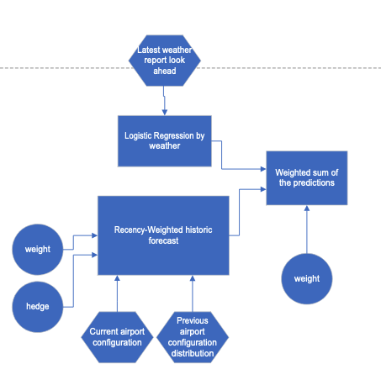
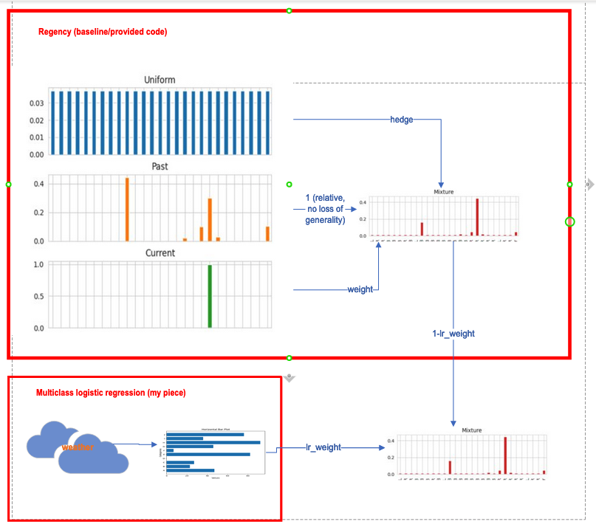
Summary of idea

Slide 8
"Above and beyond":
Random forest
Use random forest to determine the weight between regency and logistic regression
Takes the same input as Logistic Regression PLUS current configuration (discrete variable with.
AdaBoosting:
Regenccy --> high bias/low variance
Logistic Regression --> ??
Random Forest --> low bias/high variance

Slide 9
Computation needed
Hyperparameter tuning: 2D hyperparameter tuning using ROAR for regency
Use threading
Without threading: takes about 5 hours to tune 10*17 using 100 data points per trial for 10 airports * 12 lookahead per airport. (hyperparameter is decoupled with respect to each [airport, lookout] combination because sum of log-loss is communicative)
Want to increase to 20*30 using 500 data points each
Hopefully threading+ROAR will significantly decrease time needed
Training the 10 Logistic Regression model
1D hyper parameter tuning for LR weights

Slide 10
Considerations for recurrent neural network
Pros:
Our data and predictions are of a temporal nature
Cons:
Training dataset split/specialized 10 airports * 12 lookahead is insufficient to train a large neural network
Generalizing across lookahead and airports will likely introduce significant model errors (bias) that cannot be overcome by the complexity of a RNN
I don't have any experiences doing it
Higher risk of messing something up during deployment phase if some data are incomplete.

Slide 11
Current progress – Last Updated April 2 2022 (20 days from competition due date)

Slide 12
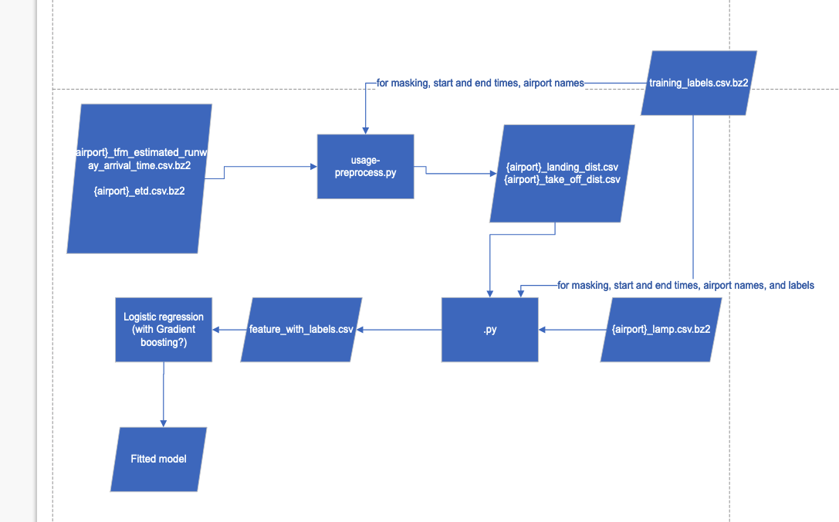
Current training architecture

Slide 13
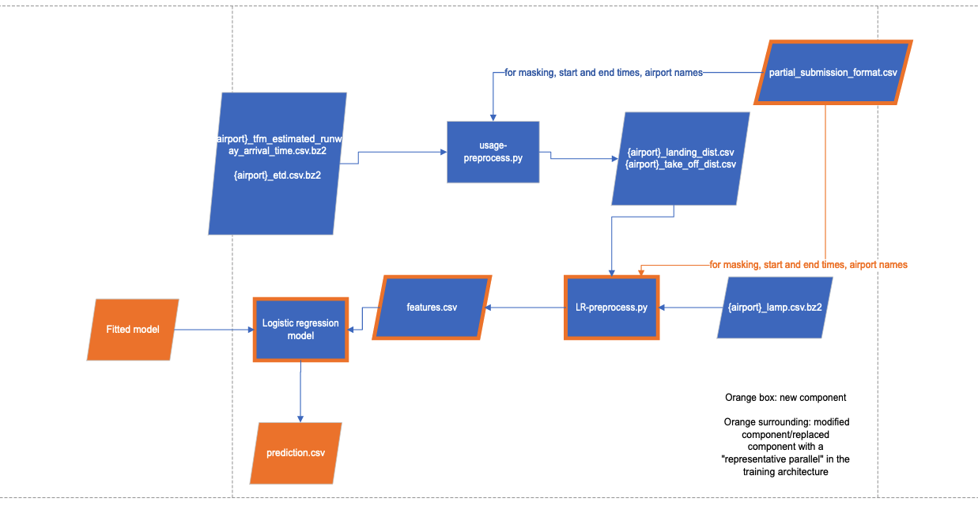
Current testing architecture

Slide 14
Tasks – last updated April 2
Training (in progress):
Usage preprocess for aircraft departure and arrival data -- Complete
Preprocessing for Logistic Regression -- Complete (UPDATE in progress: implement Lyod White sin_cos approach for wind_direction angles: 0 – 360 degrees is not linear as 0 == 360. Map to 2D using sin(x) cos(x))
Logistic Regression with Sci-kit learn – in progress (testing+debugging)
XGBoosting – todo
Submit request for XGBoost python package to NASA -- todo
Testing (todo)
Usage preprocess for aircraft departure and arrival – todo
Preprocess for model fitting – todo
Collect data and verification – todo
Deploy (todo)
Ensure code runs on simulated bench -- todo
Ensure code runs despite potential specified data outages -- todo
Verify NASA accept pull request for XGBoost python package -- todo
Deploy (submit) to NASA for final verification – todo

Slide 15
Current progress – Last Updated April 21 2022 (1 days from competition due date)

Slide 16
Current training architecture

Slide 17
Current testing architecture

Slide 18
Tried
Tested temporal decay (not very good
Added term for classes not in training data

Slide 19
Tasks – last updated April 2
Training (in progress):
Usage preprocess for aircraft departure and arrival data -- Complete
Preprocessing for Logistic Regression -- Complete (Complete: implement Lyod White sin_cos approach for wind_direction angles: 0 – 360 degrees is not linear as 0 == 360. Map to 2D using sin(x) cos(x))
Logistic Regression with Sci-kit learn – complete (testing+debugging)
Standardize data to mean=1, variance=1 - complete
Upweight May and June datapoints during training → 1/6th data accounts 4/9 of the weights, the rest 5/6th accounts 5/9 - complete
Hyperparameter training on temporal data, add term for classes not in training data - complete
XGBoosting – todo (prone to overfitting: discarded, use Logistic regression instead
Submit request for XGBoost python package to NASA – todo (used scikit learn gradient boosting instead)
Testing (complete)
Usage preprocess for aircraft departure and arrival – complete
Preprocess for model fitting – complete
Collect data and verification – todo
Deploy (complete)
Ensure code runs on simulated bench -- complete
Ensure code runs despite potential specified data outages -- complete
Verify NASA accept pull request for XGBoost python package – disgarded
Deploy (submit) to NASA for final verification – complete

Slide 20
Validation results (Logistic Regression) – temporally split off the last 1/4th of the dataset
Baseline (C=2) mean score = .1
Baseline (C=1) mean score = .1
Baseline (C=.5) mean score: 0.09846897685474114
Baseline (C=.2) mean score = 0.09629876618410152
C=.1 mean score: 0.09482931040417467
C=.05 mean score: 0.09351667526087541
C=.025 mean score: 0.0923271718253887
C=.0125 mean score: 0.09138862781015332
C=.005 mean score .0090
C=.0025 mean score: 0.09058057530870296
C = .001 mean score: 0.09102370100469091 – final configuration used for competition
C = .0001 mean score: 0.09853771147536321

